Slide 1
Capstone Project
Airbnb Booking Analysis Prepared By – Pradeep Gupta

Slide 2
Points of discussion
Introduction
Data Wrangling
Data Cleaning
Handling null and duplicated values
EDA (Exploratory Data Analysis)
Conclusion

Slide 3
Introduction
Since 2008, guests and hosts have used Airbnb to expand on travelling possibilities and represent a more unique, personalized way of experiencing the world. Today, Airbnb became one of a kind service that is used and recognized by the whole world. Data analysis on millions of listings provided through Airbnb is a crucial factor for the company. These millions of listings generate a lot of data - data that can be analyzed and used for security, business decisions, understanding of customers' and providers' (hosts) behavior and performance on the platform, guiding marketing initiatives, implementation of innovative additional services and much more.

Slide 4
Data Summary
Data set name – Airbnb Booking Analysis.
Shape of dataset - 48895 Rows, 16 Columns.
Dataset contains both categorical as well as numerical features.
Price is a dependent variable or column.
Average minimum number of nights people stay in room is 7.
Mean price of the room is 153$.

Slide 5
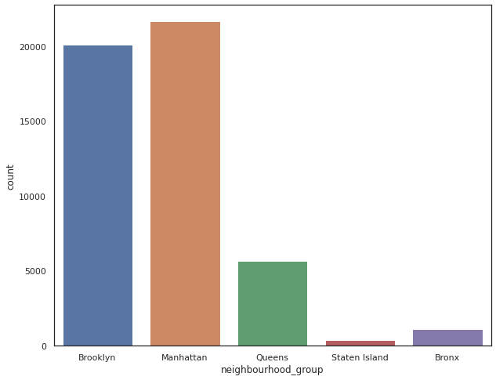
Data Cleaning
Dropped columns id, host_name and last review as they are not significant.
Columns ‘name’ and ‘reviews per month’ have null values so filled the null values.
Checked for duplicated values but there wasn’t any.
EDA on Features
There are 5 neighborhood group and Manhattan has most number of listings followed by Brooklyn.

Slide 6
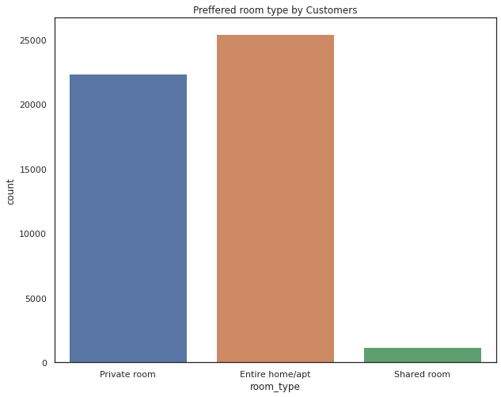
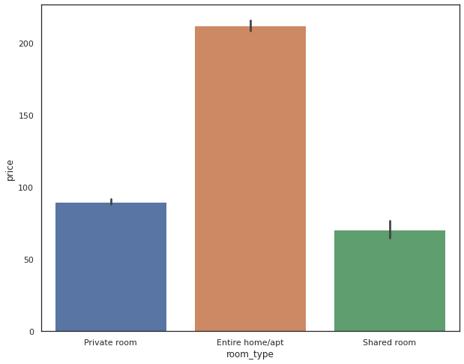
Room Type -
There are three types of room, most preferred room type is Entire home or apartment while least preferred is shared room.
Entire home/apt room type is most expensive, more than the double of private room. Shared rooms are cheapest

Slide 7
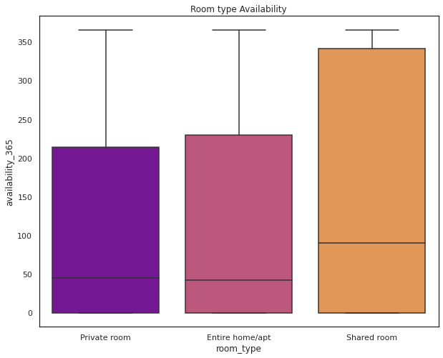
Room Type
Shared rooms have more availability than others.

Slide 8
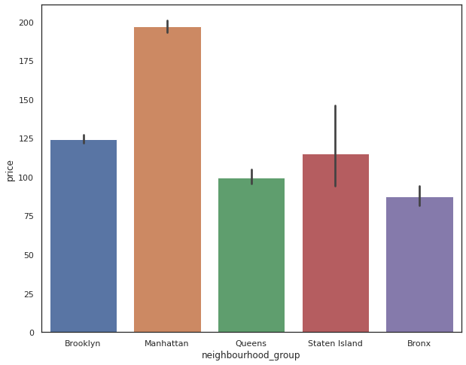
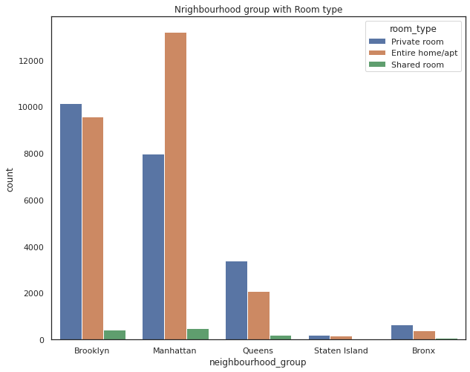
Neighborhood Group
In neighbourhood group Manhattan is most expensive followed by Brooklyn. Bronx is cheapest and we also saw Bronx has least number of listings.
Mostly Entire home/apt room type is listed in Manhattan. In Brooklyn and Queens private rooms listings is higher.

Slide 9
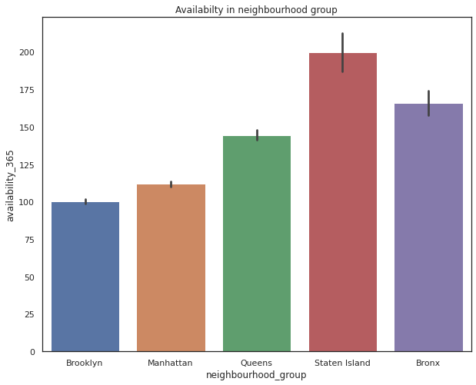
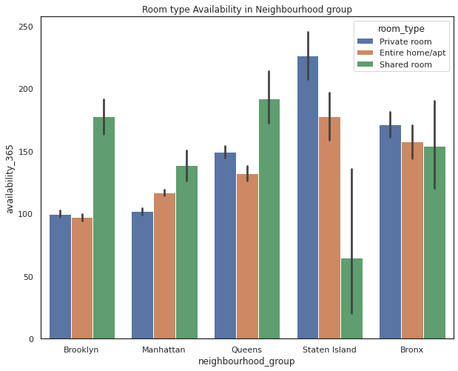
Neighborhood Group
Staten Island and Bronx have more availability may be customers prefer Manhattan and Brooklyn more that’s why they have less availability.
In Staten Island and Bronx mostly private rooms are available while in Manhattan and Brooklyn shared rooms availability is more.

Slide 10
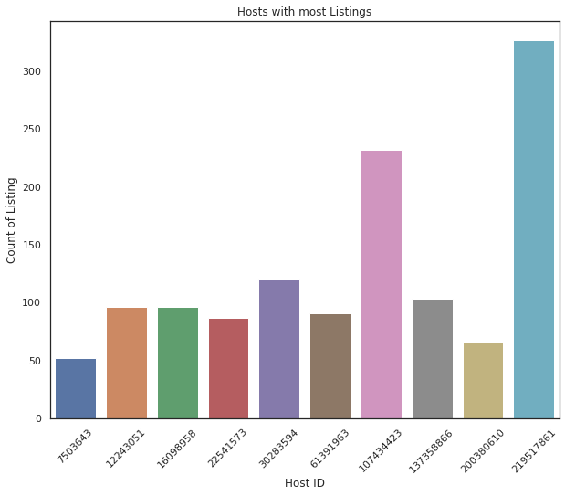
Host ID
Host ID 219517861 has most number of listings(more than 300) followed by Host ID 107434423 and Host ID 30283594.

Slide 11
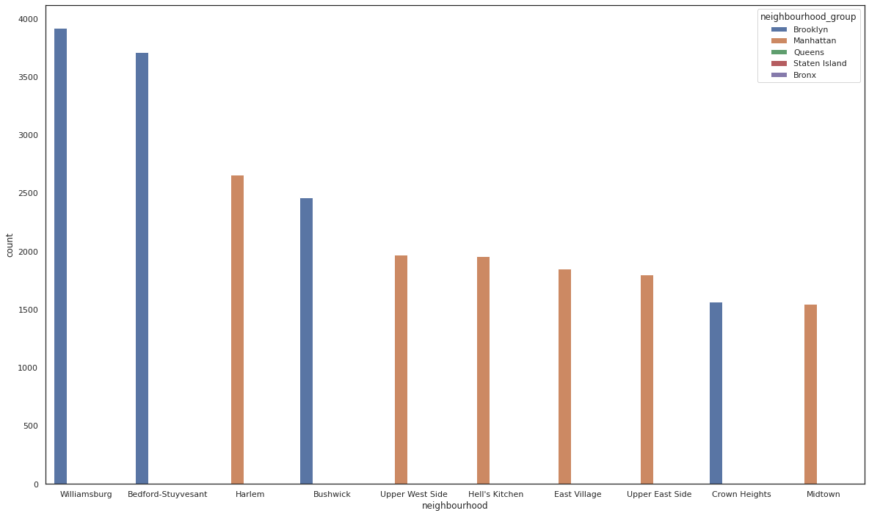
Neighbourhood
Williamsburg Bedford-Stuyvesant and Harlem are the most listed Neighbourhood in 221 Neighbourhoods while Manhattan and Brooklyn has majority share of listings.

Slide 12
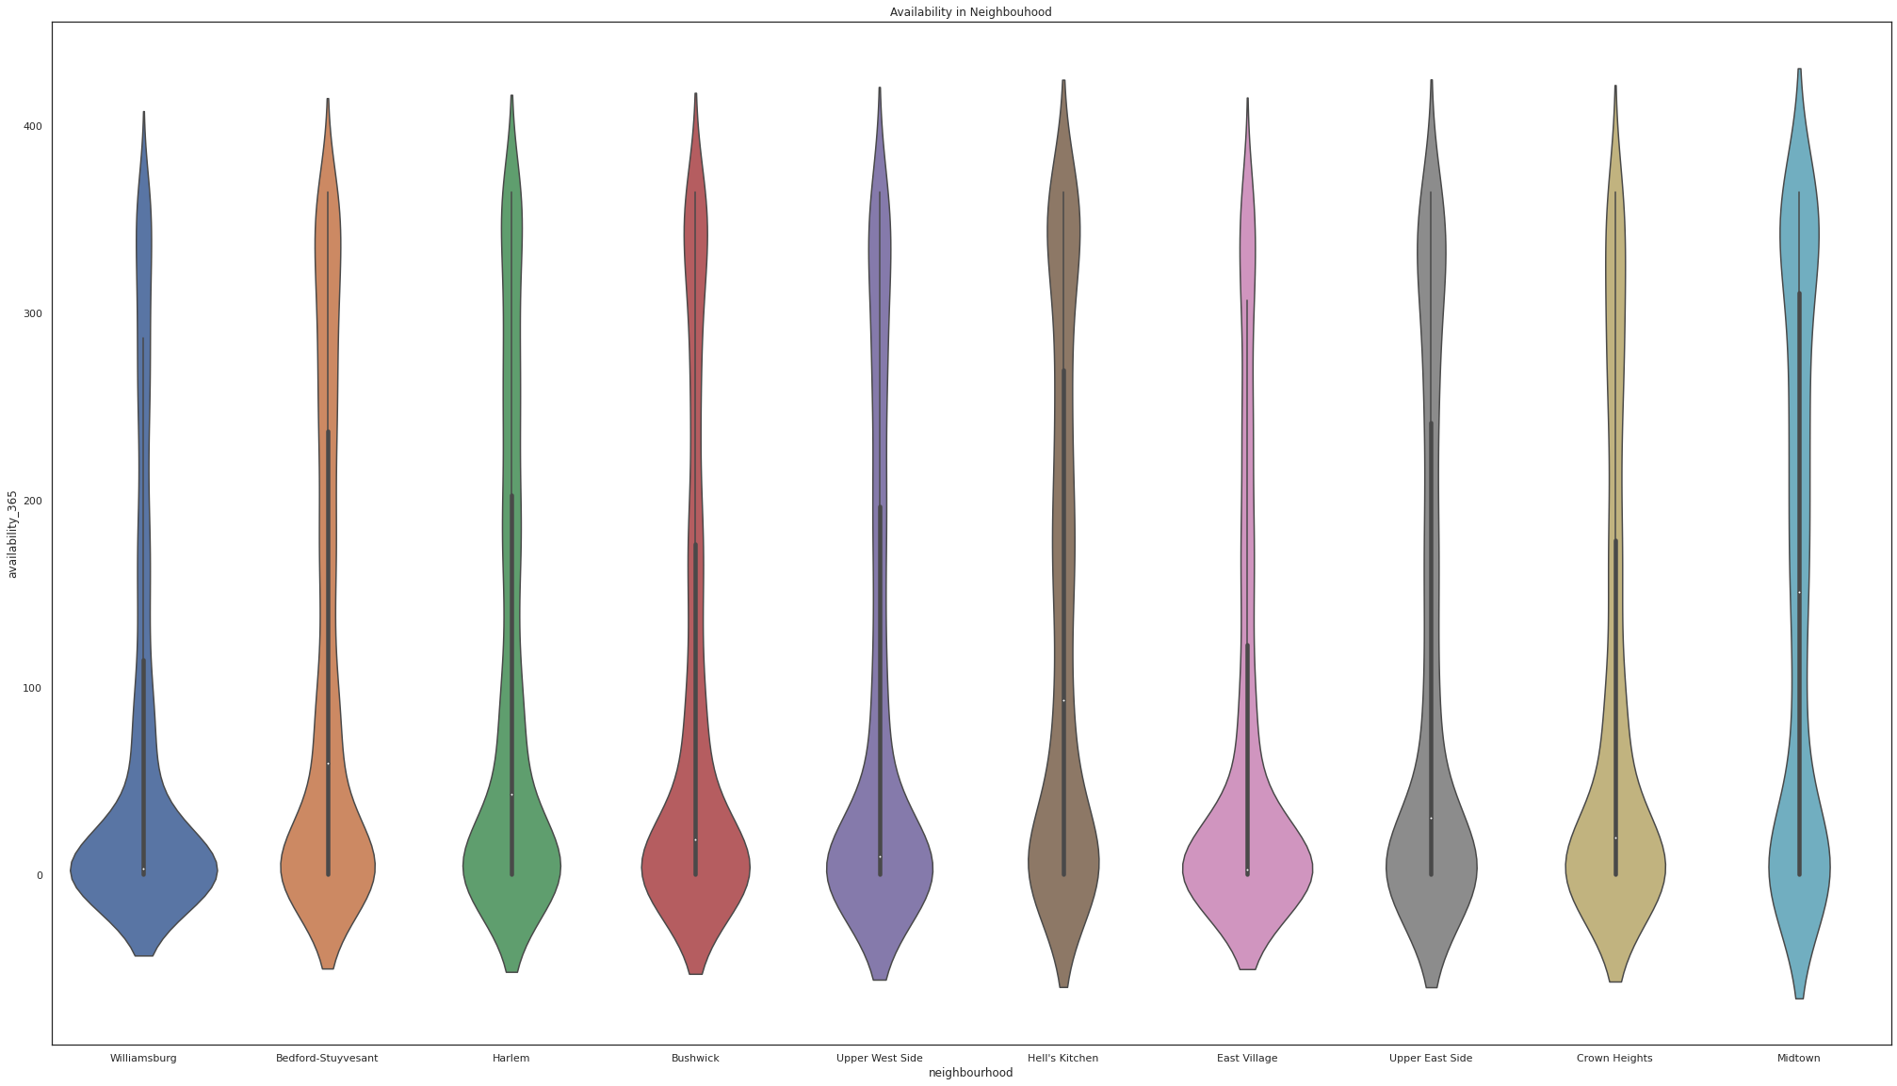
Neighbourhood
Midtown, Hell’s Kitchen, Bedford-Stuyvesant and Upper East Side have the most number of availability.

Slide 13
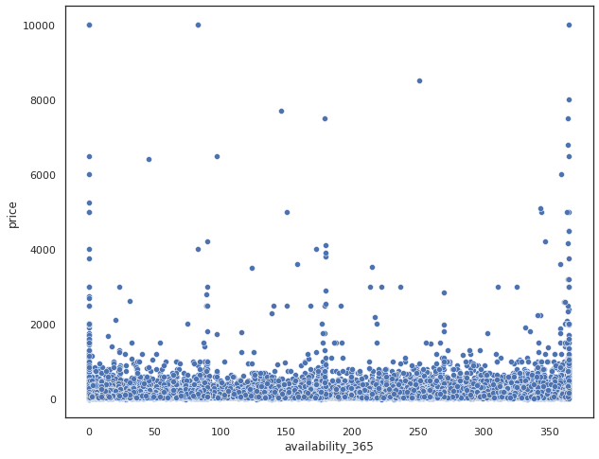
Availability_365
We can see rooms with price below approx. 1000$ have most availability while rooms above approx. 1000$ are less as we all know only some people can afford expensive rooms.

Slide 14
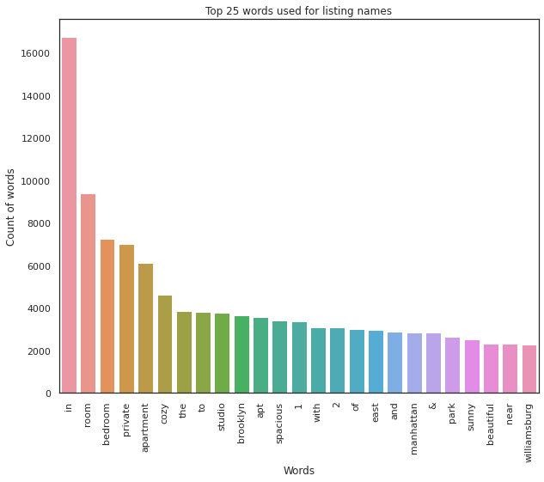
Name
Top words used for listing names are in, room, bedroom, private and apartment.

Slide 15
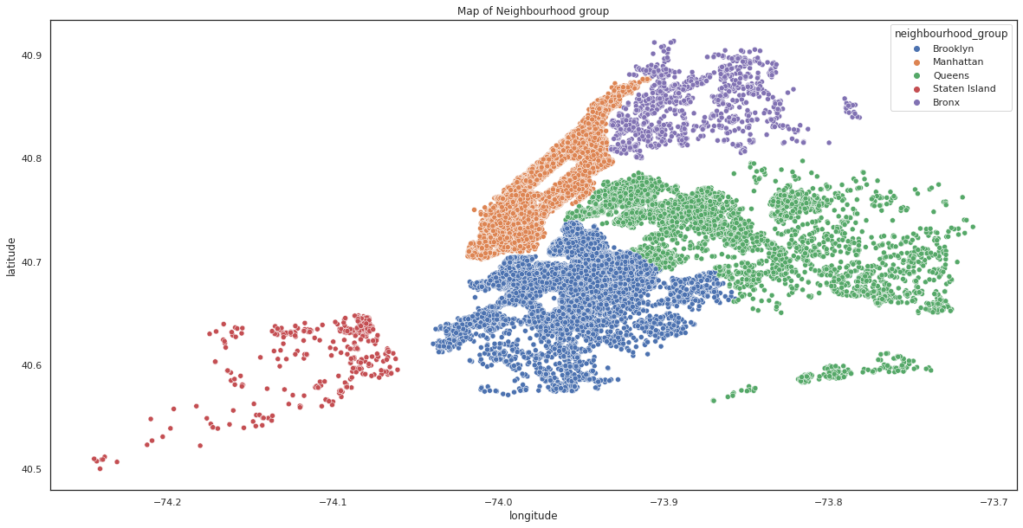
Latitude and Longitude

Slide 16
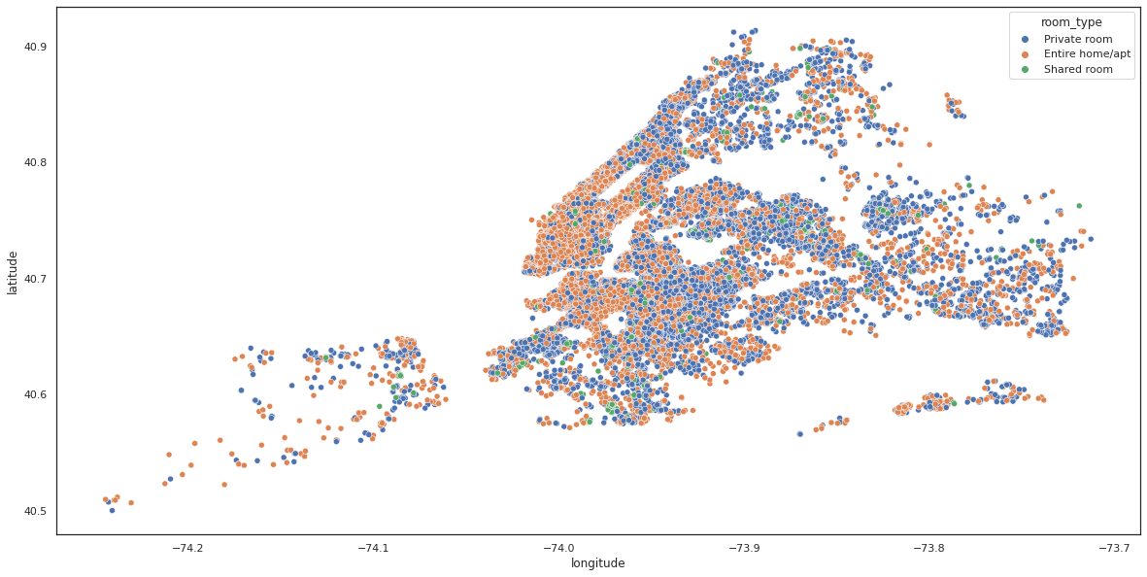
Latitude and Longitude

Slide 17
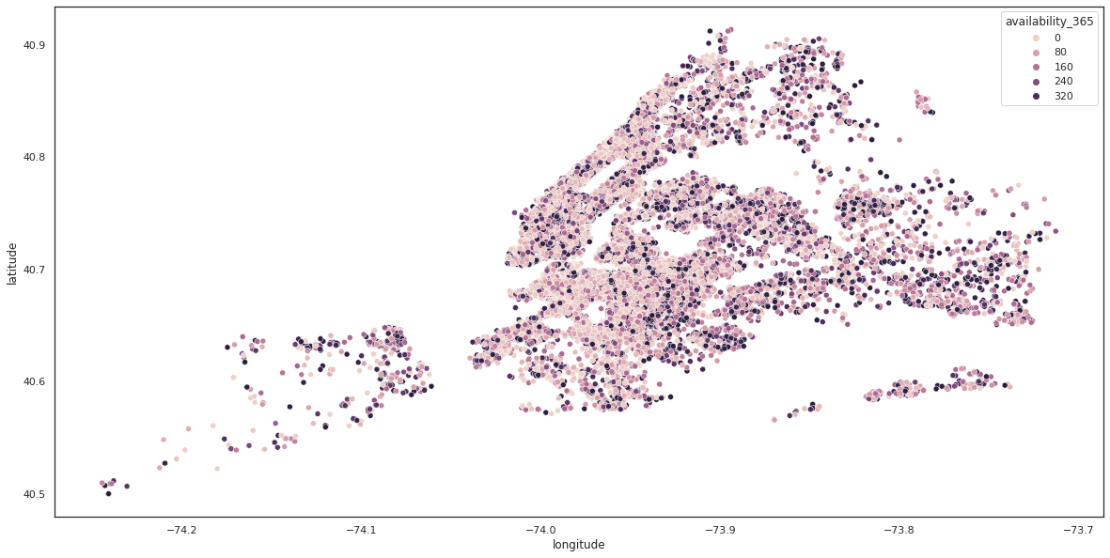
Latitude and Longitude

Slide 18
Conclusion-
In 5 neighbourhood groups Manhattan has most number listings and Staten Island has least number of listings.
There are three types of room and in these Entire home or apartment is mostly preferred while shared rooms are less preferred.
Entire home or apartment room type is most expensive and share rooms are cheaper.
Shared rooms have more availability than others.
Manhattan and Brooklyn neighbourhood group are most expensive.
Williamsburg Bedford-Stuyvesant and Harlem are the most listed Neighbourhood in 221 Neighbourhoods while Manhattan and Brooklyn has majority share of listings.
Rooms with price above 1000$ have less availability as only some people can afford expensive rooms.
Top words used for listing names are in, room, bedroom, private and apartment.
Average minimum number of nights people stay in room is 7.
Average price per night of top reviewed places is 65$.

Slide 19
Thank You

